Slide 1

Team Members:
Aaron Medero
Ana Monique Micieli
Emmanuel Agyapong
Jonathan Rivera
Thierno Bah

Slide 2
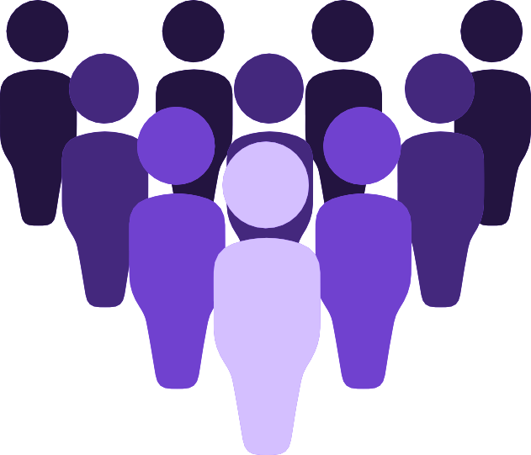
The Business of Online Dating
Because of busy work schedules, online dating has become one of the most popular ways for single people to connect and date with like-minded people in the United States
In 2020 44.2 million Americans were using online dating services. And 26.6 millions were using Dating apps
Men make up for 52.4% of online dating compared to 47.6% of women. However, the percentage can change depending on the location and service used.
52.4%
47.6%

Slide 3
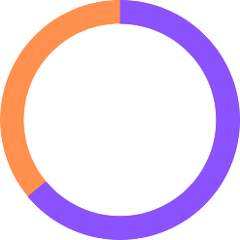
The Business of Online Dating
12%
64%
64%
Of online daters said it was easy to find people on online dating services that shared common interests
Of online daters found someone they wanted to meet in person through online dating services
Of current, committed relationships began online

Slide 4
Why Teching?
Teching Dating app was created to facilitate people with the same interest and enthusiasm for technology to meet and date like minded people that have at least one common passion!

Slide 5
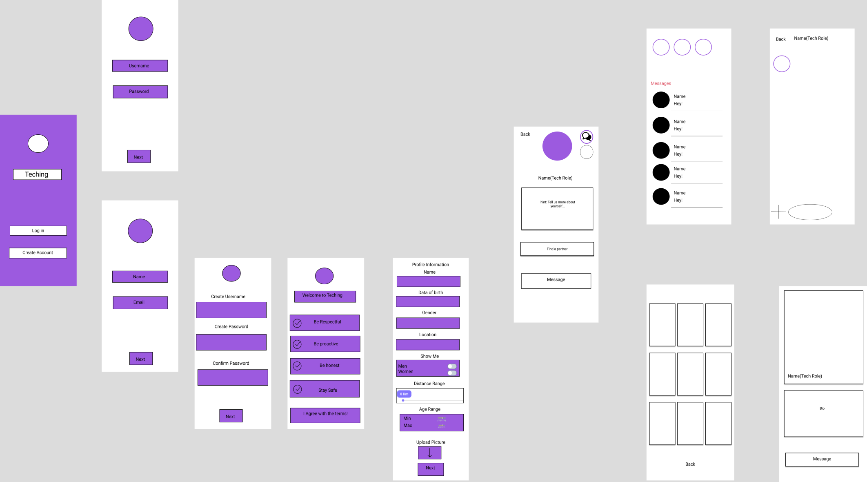
App Prototype

Slide 6


Project Ownership (Front End Team)
Ana Monique Micieli
(Front-end + design)
Designed the app
User experience
Created layouts
Used glide library / circle imageview library
Decided on colors, fonts, logo and name
Jonathan Rivera
(Front-end + design)
Designed the app
User experience
Created layouts
Created Intents to go from one layout to another
Terms of service Activity java file
Decided on colors, fonts, logo and name

Slide 7



Project Ownership (Back-End Team)
Thierno Bah
(back-end + database)
Designed database
Created database
Back end of login screens
Emmanuel Agyapong
(back-end + database)
Designed database
Created database
Back end of login screens
Aaron Medero
(back-end + database)
Designed database
Created database
Back end of alarms and login screens

Slide 8
Team Challenges
Work together as a group since each member have other jobs/responsibilities and have different time availabilities
Run the project in everyone's computers because Android Studio is unstable
Android studio bugs
Discussions on changes of the app layout and other features, to whether or not we use/remove it.

Slide 9
Lessons Learned
Work constructively with other people to solve problems as they appeared.
Never underestimate the time a task can take to be done.
To aim for great quality instead of perfect quality.
What is logical for one developer may not be logical for other developers.

Slide 10
Clarity of hindsight
Instead of having front-end and back-end sub-groups, we could have splitted our app in different sections and work on these sections before moving to the next one.
Assume challenges that can change the functionality of the code.
Design with the user in mind

Slide 11

Proud Accomplishments
We learned how to manage our time to work together as a group despite our different availabilities.
Our ability to adapt and change our project as needed in terms of code and design.
Listening and learning from our mistakes as a team.

